Slide 1
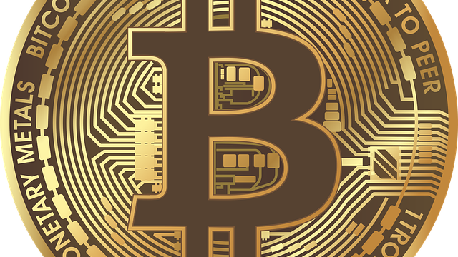
Introduction to Bitcoin
Pranay Anchuri
Prepared for Winter session 2021

Slide 2
About me
DataX Data Scientist at the Center for Information Technology Policy, Princeton School of Public and International Affairs
PhD in Computer Science
Worked as Blockchain Research Scientist at Axoni, a Series B startup in NYC.
Research areas :
Blockchain
Network analysis
Machine learning
Algorithms for mining patterns in large scale networks
Acknowledgements Pranay Anchuri gratefully acknowledges financial support from the Schmidt DataX Fund at Princeton University made possible through a major gift from the Schmidt Futures Foundation.

Slide 3
Logistics
Check-in @ http://cglink.me/c837440925124116

Slide 4
Outline
History of money
Cash
Cryptographic primitives
Demo
Bitcoin

Slide 5
Outline
History of money

Slide 6
History of money
6000 BC – Present day
Notes:
Money is an asset used to buy or pay for exchange of services

Slide 7
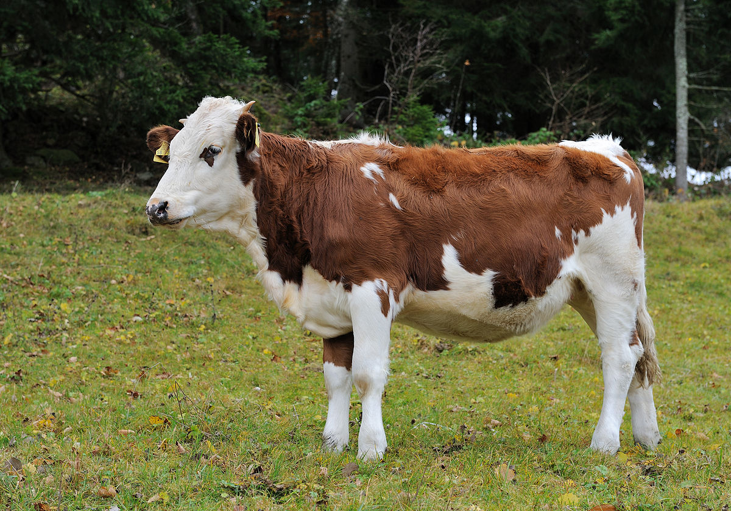
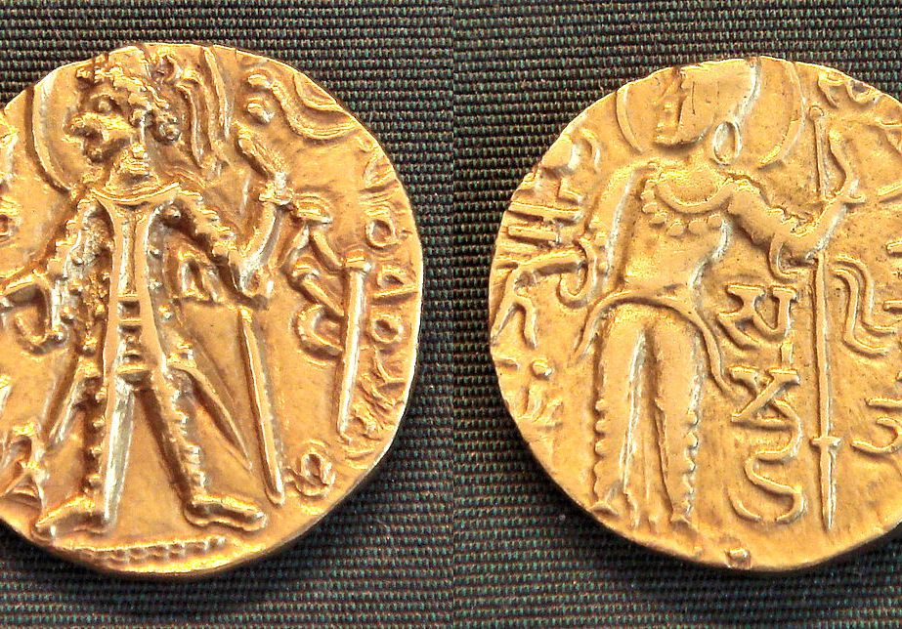
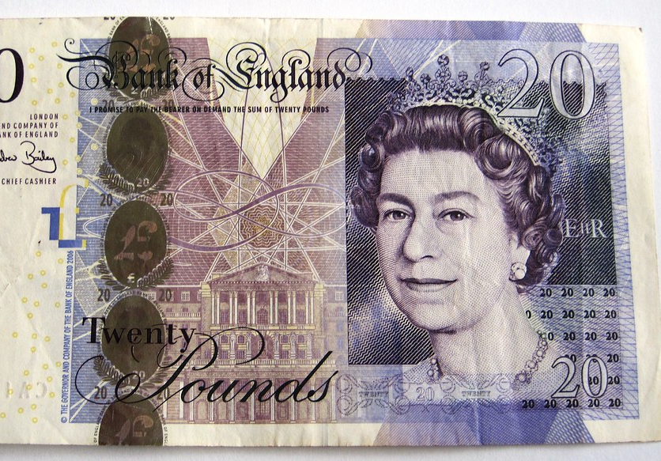

Four phases
Transition from a medium coupled with commodities to credit money
Notes:
Look at history of money in 4 phases

Slide 8
Terminology
Monetary system
Units of value and medium of exchanging value
Key elements in a functioning market economy
Unit
Quantity of economic value
All items in the economy can be priced as multiples of unit
Medium of exchange
Item whose value is proportional to the unit
Easy to store
Obtains value from its acceptance, purchase power
Notes:
Units : Everything is priced
Medium : Thing that is exchanged

Slide 9
Phase 1
Commodity exchange

Slide 10
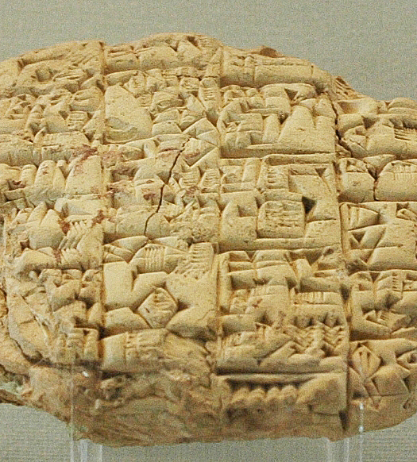
Commodity exchange
Units were usually commodities
Bushel of grains, precious metals
Precious metals have become medium of exchange
Early records of debt-based payments
Debt issued by trusted parties were accepted forms of payment
No common medium of exchange
Bilateral credit for transactions and settlement for net amounts
Transition to a standard unit and state issued coins

Slide 11
Phase 2
Rise of coinage

Slide 12
Coinage
State | Public
Project sovereignty | Less value outside the state
Can create money by using lesser metallic content | Less intrinsic value
Source of revenue | Acceptance of tax obligations
State issued precious coins became medium of exchange
State ascertains weight and quality of coins
Coins represent more than the metal it contains
State vs public
Transition to a more available medium

Slide 13
Phase 3
Credit money

Slide 14
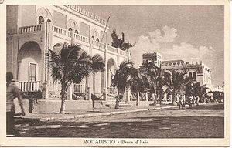
Credit money
Coinage was successful except for the wide availability
People were still using bilateral credit
Introduction of modern banks (central and commercial)
Credit money - People gave up ownership of coins and receive debt against bank
Credit money becomes a medium of exchange
Promise to exchange for precious metals
Banks were required to keep a fraction of total value, lending business
Government accepted notes for taxes

Slide 15
Phase 4
No more gold standard

Slide 16
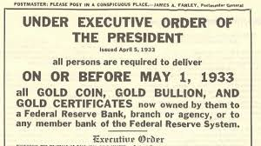
Modern system
Difficult to support convertibility to Gold
State cannot pump-in money during emergencies
After wars and economic crisis gold conversion was abandoned
State ensures paper money is accepted
Availability problem is solved
New problem – excess availability

Slide 17
Outline
History of money
Cash

Slide 18
Cash as a medium of exchange
Exchange is true ownership transfer
Receiver becomes the owner of the unit of value
Privacy
Central authority doesn't keep tabs on the balances
No counterparty risk
No entry barrier for new participants
Notes:
Unlike other financial instruments bonds, bank deposits there's no counterparty risk only issuer risk

Slide 19
Physical cash vs Digital cash
Physical cash
Cash exchanges requires both parties to be at same location
Limited denominations makes handling cash tedious
Difficult to transfer large amounts
Digital cash
+Digital version of cash and transfers
Venmo, PayPal, Zelle
+Allows cross border transfers
Xoom
-Requires a central authority (bank) to maintain account balances
- Not everyone is banked yet!

Slide 20
Electronic cash with properties of physical cash
Why ?
Ease of electronic cash
Privacy of physical cash
DigiCash
Earliest attempt at a digital version of cash with spender privacy
Banks issue tokens which can be redeemed later. Deposits and redemption cannot be linked
Failed for a variety of reasons
Bitcoin is the first digital cash which can function without any central authority!
Ahead of its time – ecommerce was still in early stages
Banks were not onboard

Slide 21
What is Bitcoin
/
A monetary system without a central authority (state)
Unit of value : Bitcoin/Satoshi
100 million Satoshi = 1 Bitcoin
Medium of exchange is a data file that proves ownership of Bitcoins
Pre-defined supply
No intrinsic value (similar to current CB issued currencies)
Notes:
Not just digital cash but also introduced deterministic supply

Slide 22
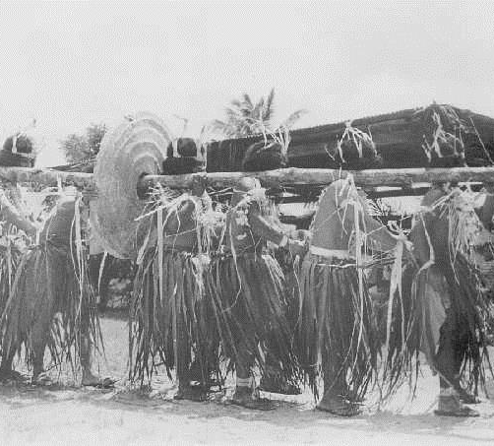

Decentralized value exchange system
Yapnese stone money

Slide 23
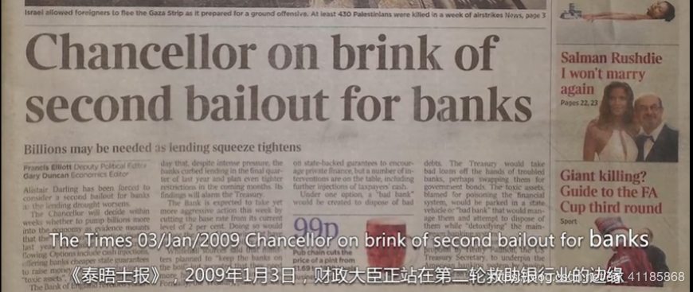
Origin of Bitcoin
This Photo by Unknown author is licensed under CC BY-SA.

Slide 24
Decentralized economy of Yap island
People know each other
Millstone like stones are used in value exchange
Everyone knows who owns what
Payments are gossiped throughout
Conflict resolution
Anyone can bring stones to the island

Slide 25
YapStone vs Bitcoin
Bitcoin replicates YapStone like economy at larger scale
Stone exchange works at small scale and where reputation is at stake for misbehavior
Unique challenges for digital YapStone
How to reach population level consensus ?
Cannot identify participants
Control of supply
Double spend
Censorship issues

Slide 26
Outline
History of money
Cash
Cryptographic primitives

Slide 27
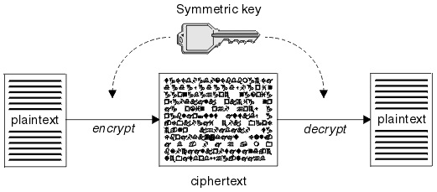
Symmetric key encryption
Same key to encrypt and decrypt
Heavily used during WW2

Slide 28
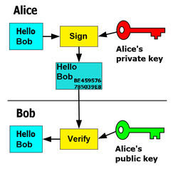
Asymmetric key based signature
Key has two parts : Public key and private key
Public key is my identity
Private key is used to decrypt messages sent to me (encryption) and sign messages to prove ownership of identity
Signatures used when redeeming coins

Slide 29
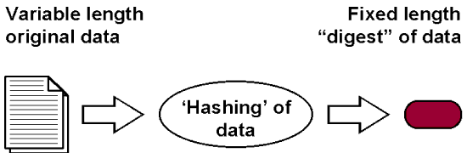
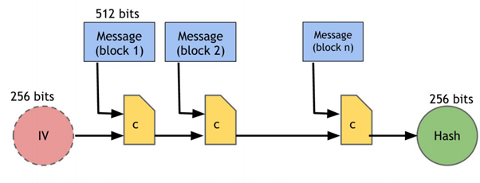
Cryptographic hash
Hash is a mathematical function (h) that maps any data to fixed length summary
Used to uniquely identify transactions
Not all mapping functions fit requirements

Slide 30
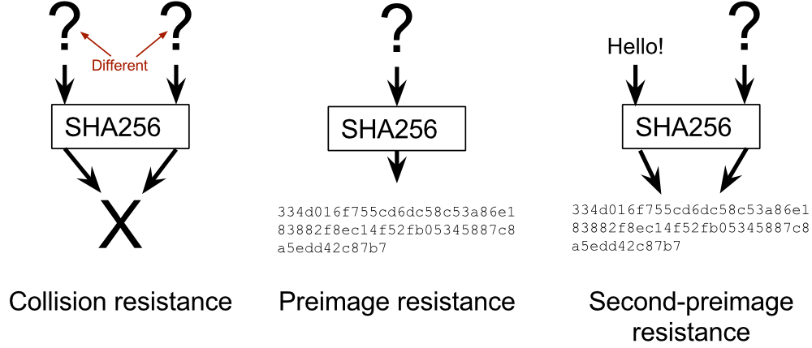
Properties of hash function
Pre-image resistance
Given the hash digest 'm', it's difficult to find data 'd' such that h(d) == m
Second pre-image resistance
Given h(d) = m, it's difficult to d' such that h(d') = m
Collision resistance
Difficult to find d and d', h(d) = h(d')

Slide 31
BREAK

Slide 32
Outline
History of money
Cash
Cryptographic primitives
Bitcoin

Slide 33
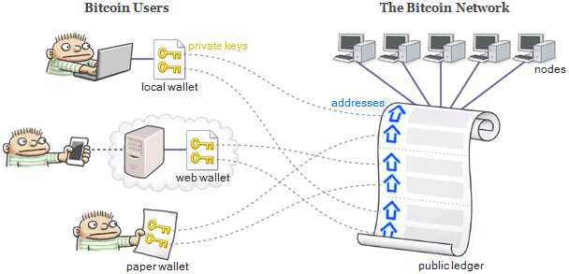
Bitcoin from the ground up
Transactions
Public ledger
Dealing with fraud
Introducing value into system

Slide 34
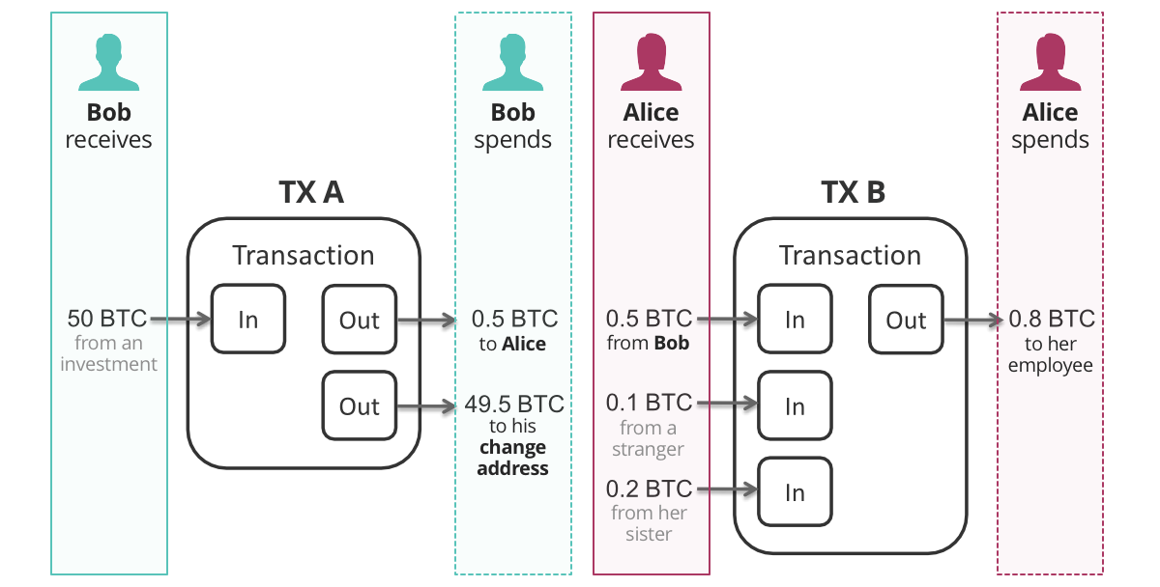
Transactions
Each bitcoin is associated with a public key
Anyone who can sign a message that tallies with the associated public key is its owner
Owner can initiate a transfer by signing a message that transfers ownership to a different public key
Multiple inputs and outputs per transaction
Value must be conserved

Slide 35
Bitcoin network
/
Transactions gossiped by Bitcoin nodes
Transaction can be duplicated without the risk of modification
Signature invalid if any part of the transaction is modified
Avoid censorship by sending transaction to nodes distributed throughout the world via internet
Satellites to avoid dependence on internet

Slide 36
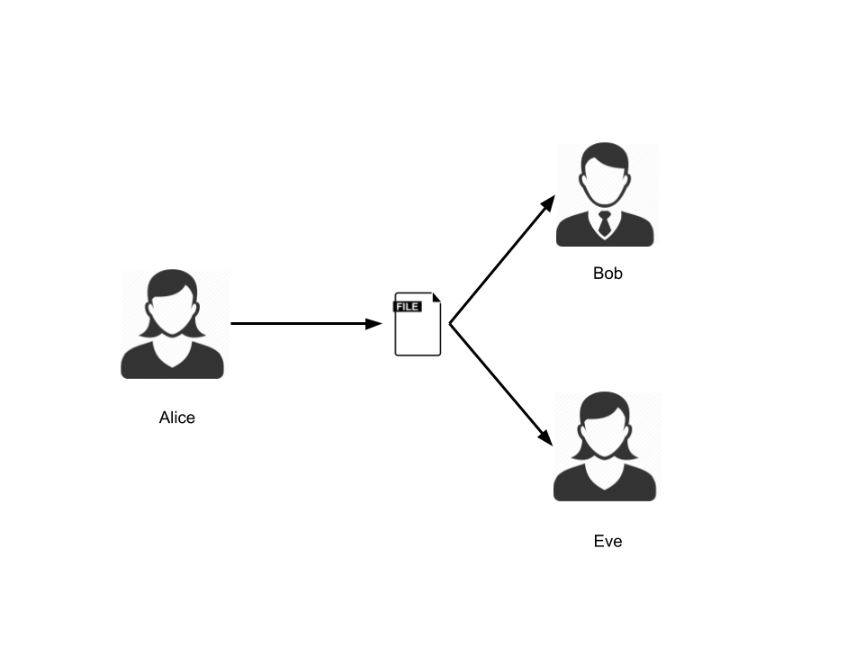
Ordering transactions
Everyone keeps a record of all the unspent Bitcoins in circulation
Double spend problem
Alice pays the same Bitcoin to Bob and Eve, simultaneously
No central authority to decide correctness
Anyone can participate in deciding the order
A game theoretic approach to incentivize correct behavior and penalize misbehavior

Slide 37
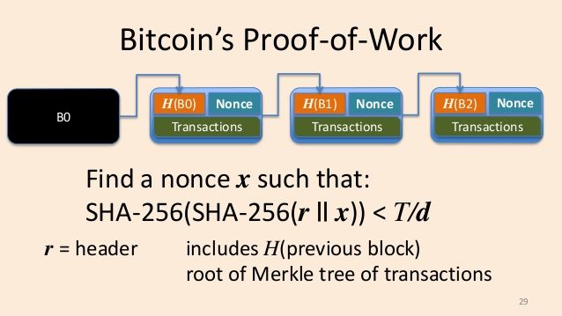
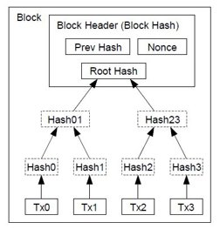
Proof-of-work
Transactions are grouped into blocks
Miners solve hash-based puzzles for the ability to propose new blocks
Probability of solving the puzzle is proportional to the amount of computing power
Similar approach was used in combating spam
Solve puzzle before sending an email
Notes:
Penalizing misbehavior

Slide 38

SHA256 and Proof-of-work demo

Slide 39
Mining incentives
Miners are rewarded for including transactions
Pay what you wish model
Miners also create a special Coinbase transaction (that assigns new bitcoins to self)
Transmits newly minted blocks on the network
Notes:
Incentives for proposing blocks

Slide 40
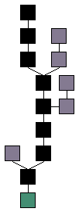
Consensus
Forks can happen even with perfect incentives
Miners are free to choose to link their block from any point of the chain
Blockchain is more of a tree
The consensus is that the largest chain is the "correct" version of history
Rational miners want to participate in the correct version
Resources (used in solving hash puzzle) are wasted if subsequent blocks don't build on their blocks
Notes:
Why forks happen ? Network delays, intentional misbehavior by miners

Slide 41
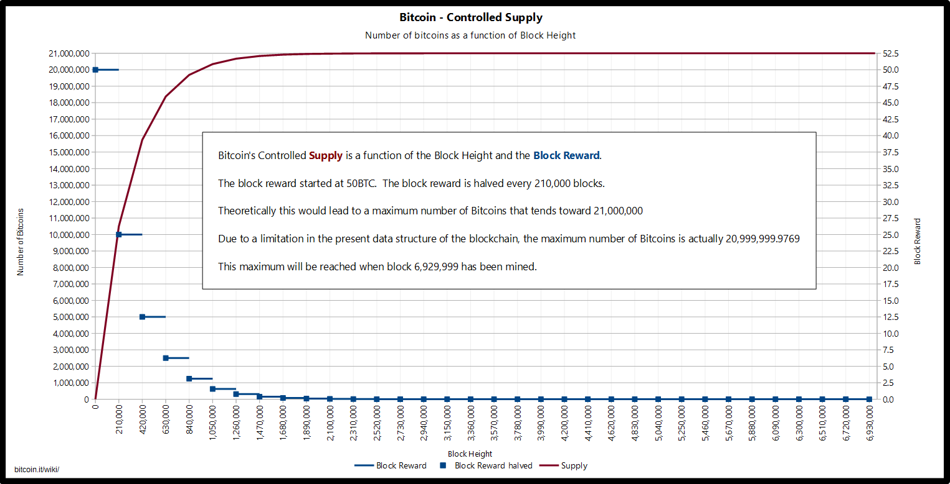
Controlled supply

Slide 42
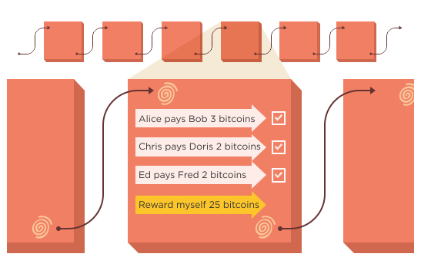
Putting it all together
Bitcoin blockchain is a decentralized value exchange system
Users create public key-based identities
Suggested to create a new identity for each transaction
Transfer ownership of bitcoins by signing a transaction with private key
Miners accumulate transactions, solve hash-based puzzles to order the transactions
New bitcoins are introduced via mining rewards
Everyone updates their copy of the blockchain

Slide 43
Properties of Bitcoin
Censorship resistane
Permissionless
Fungibility
Anonymity
Fixed supply
No centralized risk

Slide 44
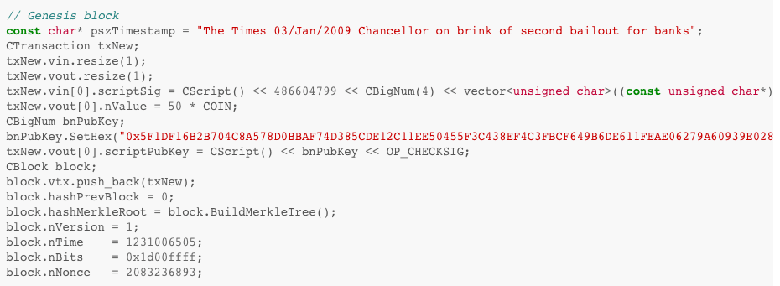

Origin of Bitcoin

Slide 45

Inspecting a bitcoin block
Block 666526

Slide 46
Applications
Beyond value transfer

Slide 47
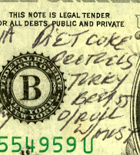
Colored coins
Colored coins are bitcoins annotated with a special meaning
Linking physical assets like tickets, airline miles etc.
Uses Bitcoin infrastructure to easily transfer, trace etc.
Colored bitcoins can hold more value
Issuer risk
Colored coins have value only if the issuer accepts them

Slide 48

Colored coins example
Alice
1 BTC & 10k miles
Bob
1 BTC & 10k miles
1 BTC, 10k miles
Airline Issuing Address
5 BTC
4 BTC
Airline Redemption Address
Offline Tx
Redeem ticket

Slide 49

Challenges
Fierce competition among miners to solve proof-of-work puzzles
Around 6.25 BTC/~250k USD per block at stake
Requires huge amounts of energy per block
Bitcoin network processes around 10 transactions per second
Visa throughput is around 10k transactions
Transactions are not completely anonymous

Slide 50
Outline
History of money
Cash
Cryptographic primitives
Demo
Bitcoin

Slide 51
Recap
History of money
Origins of digital cash
Bitcoin protocol
Applications
Next part : Ethereum

Slide 52
Announcements
https://forms.gle/UmNt4Hokq7f26Xmu8 - optional survey
Paid summer RA positions

Slide 53
You want an OP_RETURN transaction. Easiest way I know of to generate one is to go to https://coinb.in/#newTransaction and click the advanced options button, then check "Allow data to be sent within the transaction and stored in the blockchain by using OP_RETURN."
Then use some text to hex data converter (google it) to type in your text and get it translated into hex.
When you go to enter your outputs, make 3 of them, make one be the receiving address, one be the change address, and one be the hex data of your text (up to 80 bytes I believe).
That's if you want to send a transaction to someone that has a message in it.
If you just want to send a message to be preserved in the blockchain, you can use something like http://eternitywall.it/
This is what one of thsoe looks like on the blockchain (note the "decoded" portion in the non standard output) https://chain.so/tx/BTC/27daac15b942454b32f913a41633151163d1921b0c7bf6ddbea6020462d805ee

